Slide 1
Introduction to Arduino
By Gabriel Unger

Slide 2
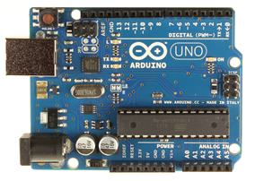
What is Arduino?
Open-source physical computing platform
Atmel AVR ATmega microcontrollers
Free, simple IDE with built-in functions
Arduino Programming Language (C/C++)

Slide 3
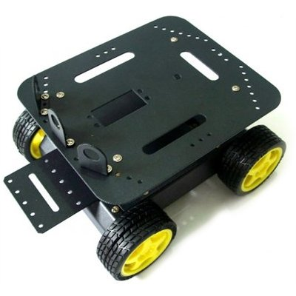
What is Arduino Used For?
Standalone systems
Robots
Pervasive computing (smart home)
Interface between physical world and computing world
Our project
Transducers feed Arduino
Arduino feeds a system

Slide 4
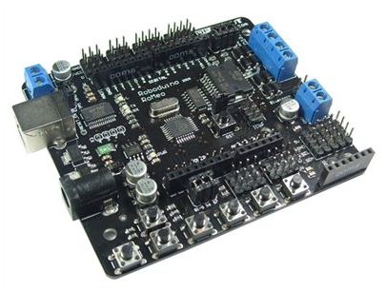
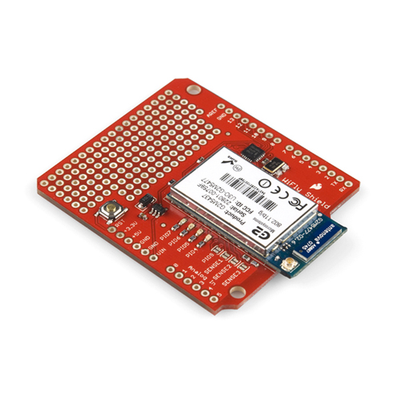
Why Arduino?
Easy
Pre-made official boards
C/C++
Open
Third-party boards
“Shields” extend functionality
Popular
Community-developed libraries
Online support community

Slide 5
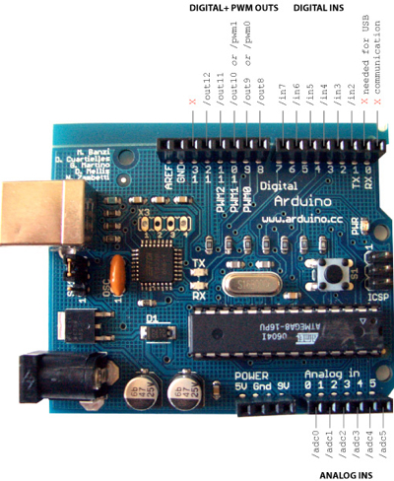
What Can Arduino Do?
Processing and Storage
Capable processor (robot brain)
SRAM, EEPROM, SD
Connectivity
Basic digital, analog I/O
Serial
Bluetooth
WiFi
Zigbee
NFC/RFID
Ethernet

Slide 6
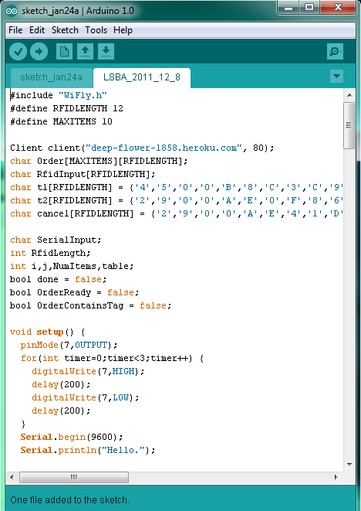
Programming an Arduino Board
Arduino IDE
Version 1.0
Free
C/C++
“Sketches”
One or more programs
.ino extension
setup() and loop()
Any other IDE
Must support ATmega
Few advantages

Slide 7
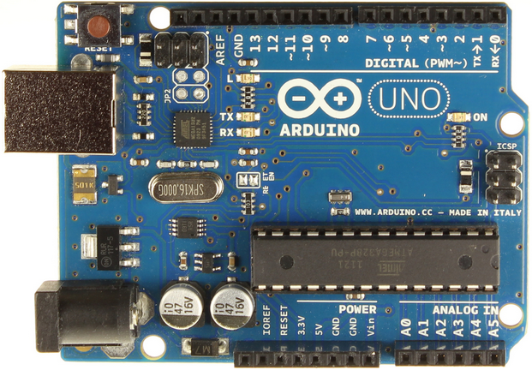
Arduino Uno
Latest official Arduino board
ATmega328
8-bit
14 digital I/O (6 PWM)
6 analog inputs
16 MHz
5V
32 KB of program memory
2 KB of SRAM (variables)
1 KB EEPROM
Serial port
SPI port
2 external interrupts
AREF

Slide 8
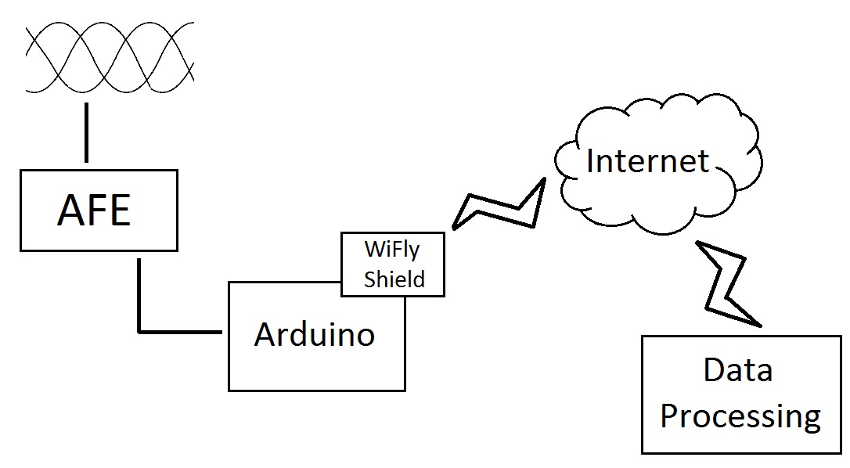
How Arduino Fits Our Project

Slide 9
Analog Front End (AFE)
Grabs raw sensor outputs
Voltages
Currents
Provides data to next level of processing
Some provide advanced features
Fundamental frequency
Harmonic power
Power factor

Slide 10
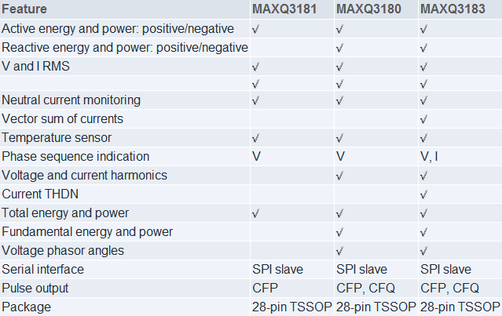
Maxim AFE Devices

Slide 11
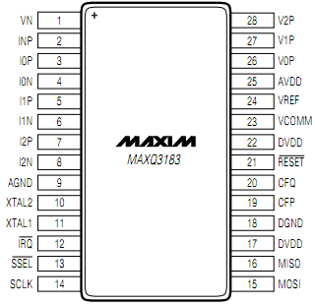
MAXQ3183 Overview
3-Phase voltage, current
~$20 direct from Maxim
TSSOP (tiny)
SPI
3.3V
35 mW typical
7.6 MHz internal clock

Slide 12
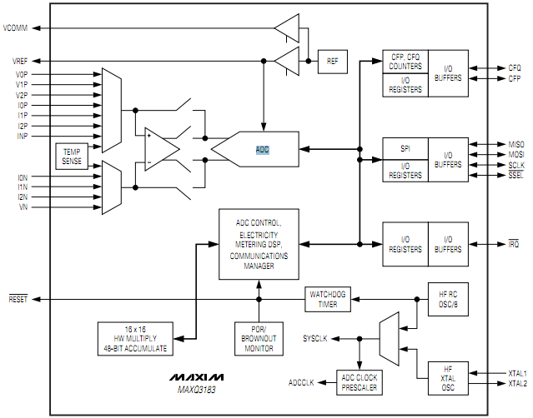
MAXQ3183 Internals

